Slide 1
Low Collateral Blockchains loans
By Raphael Charbit and Doron Slomovits

Slide 2
Introduction
Collateral definition, collateral replaces trust
What is DeFi?
Lending, the most important financial activities
Why to take a Loan?
The two types of risk
The current solution to the risk
The tradeoff of the solution
Notes:
Colateral: In the DeFi space, 'collateral' is similar to a digital security deposit in cryptocurrency that you provide to secure a loan; if the loan isn't repaid, the platform keeps your deposit, acting like a modern-day pawn system in the digital world of blockchain.
Defi: DeFi, or Decentralized Finance, is a financial concept using blockchain technology to create an open system without traditional intermediaries like banks. Instead, smart contracts on the blockchain enable services such as lending, borrowing, and trading. Users have complete control over their assets, making DeFi accessible to everyone.
Lending: accounting for about 80% of all financial transactions worldwide.
Two types of risk : Lending on platforms like Compound or Aave is like sailing in the open sea of blockchain: first, you face the waves of currency volatility, where the value of your cryptocurrency can rise or fall dramatically, much like the unpredictable ocean tides. Second, there's the mist of borrower anonymity, where you lend to faceless entities without knowing their identity, akin to navigating through a foggy sea without seeing the other boats.
Current solution : provide more cryptocurrency as collateral than the amount you're borrowing. This extra cushion helps protect lenders against the ups and downs of crypto values, ensuring they're more likely to get their money back even if market prices tumble.
Tradeoff: Notre objectif est de reduire le collateral demander tout en gardant la securite de l argent des preteurs

Slide 3
Background on DeFi lending protocols
How does a loan with collateral work?
3 possible ways at the end of a loan
Collateral as Security: Borrowers secure loans by offering assets (like cryptocurrency) as collateral.
Loan Amount: Determined by the collateral's value.
Smart Contract Role: Automates the loan terms on the blockchain.
Consequences of Default: Collateral compensates the lender if the borrower defaults.
Repayment Obligations: Adhering to the contract's schedule is crucial.
Receiving Funds: Borrower gets cryptocurrency loan.
Notes:
How loan with collateral work?
Collateral as Security: Borrowers secure loans by offering assets (like cryptocurrency) as collateral.
Loan Amount: Determined by the collateral's value.
Smart Contract Role: Automates the loan terms on the blockchain.
Receiving Funds: Borrower gets cryptocurrency loan.
Repayment Obligations: Adhering to the contract's schedule is crucial.
Consequences of Default: Collateral compensates the lender if the borrower defaults.
End a Loan:
Repayment: Borrower repays the full loan amount plus interest, ending the loan and releasing the collateral.
Liquidation: If collateral value drops below a set threshold, it's sold to cover the loan, protecting the lender.
Background: When a borrower like Bob takes a loan, he provides collateral in another cryptocurrency.
Decrease in Platform's Reserves: Due to market fluctuations or high withdrawal activities, the platform’s reserves in the base cryptocurrency (e.g., Ether) decrease.
Platform's Action to Replenish Reserves:
The platform uses its own reserves of the base cryptocurrency to purchase collateral from borrowers.
This transaction is a direct exchange between the platform and the borrower (Bob).
Bob receives the base cryptocurrency from the platform in return for his collateral.
Outcome:
The platform holds the collateral, which can be used or sold later.
This helps in managing the platform’s liquidity and reserve levels.
Purpose: Such actions are strategic decisions by the platform to maintain a healthy balance of assets and ensure smooth operations.

Slide 4
Aave and Compound

Slide 5
Liquidity pool
No direct relation between borrower and lender
The plateform checks if the borrower met the borrowing conditions
Providers of liquidity can withdraw their funds from liquidity pool at any time.
Notes:
Liquidity Pool: a collective fund of assets, contributed by users, that provides the necessary liquidity for fluid and efficient trading and other financial activities on the platform.

Slide 6

Interest rate
If the capital is available: low interest rates to encourage borrowing
If the capital is scarce : high interest rates to encourage repayments of debt.
Interest rates are updated in continuously, so they change in real time: everytime the market change or a transaction is made.

Slide 7
Aave
A decentralized crypto lending platform Ethereum Based
Specialized in overcollateralized loans
Protects lenders from losing money
Offers flash loans.
Notes:
Flash Loans: Instant, large-scale loans without collateral, borrowed and repaid within one transaction block. Useful for quick financial strategies like arbitrage, automated debt repayment.

Slide 8
Compound
Ethereum based
A DeFi platform that enables users to deposit and borrow various resources.
Overcollateralization
Does not provide flash loans
COMP Token

Slide 9
CToken and COMP
CTokens
represents the deposit of the lender in the lending pool
Can be transferred or exchanged
COMP
provides governance rights to its holders
encourage users to use the Compound protocol
Can only be exchanged for the cryptocurrency initially deposited

Slide 10
How Compound v2 Utilizes Money Markets and cTokens
Users deposit underlying assets (e.g., ETH, DAI, USDC) into the money market smart contract.
Receive cTokens (e.g., cETH, cDAI, cUSDC) representing their deposits.
Users can redeem their cTokens for the underlying asset, including any earned interest.
cTokens can be traded, used as collateral, or integrated with other DeFi protocols.
Notes:
cToken : a token representing a user's participation in Compound. When a user deposits funds, they receive cTokens, representing their share in the liquidity pool. These cTokens change in value based on the deposited assets and accrue interest for holders. Ctoken allows users to earn interest and engage in lending and borrowing activities.

Slide 11
Liquidations and Collateral Factors in Compound v2
Successful Loan Example:
Bob's Borrowing: Bob borrows $1,000 from Alice, give $1,500 as collateral.
Repayment: Bob repays the $1,000 loan with a 10% interest, $1,100.
Loan with Liquidation Example:
Bob's Borrowing: Bob borrows $1,000 from Alice, give $1,500 as collateral.
Market Fluctuation: The market value of Bob's collateral decreases sharply to $1000.
Liquidation Triggered: Because the collateral value falls below the loan amount, it is automatically liquidated.

Slide 12
Collateral & Borrowing
Important function in the protocol:
The supply function can transfer an asset to the protocol and add it to the account's balance.
The withdraw method is used to withdraw collateral or borrow the base asset from the protocol.
The collateral balance function returns the current balance of a collateral asset for a specified account in the protocol.
The isBorrowCollateralized function returns true if the account has enough liquidity for borrowing.

Slide 13
Liquidation
Health factor (or similar in compound)
Liquidated if : Health Factor < 1
Protects lenders and the protocol
When an account's borrow balance exceeds liquidation collateral factors, it becomes eligible for liquidation
A liquidator can call the “Absorb” function to initiate the liquidation process
The Liquidation function transfers the account's collateral to the liquidity pool.
Protocol receives the collateral assets in return
Notes:
If remaining reserves….
Background: When a borrower like Bob takes a loan, he provides collateral in another cryptocurrency.
Decrease in Platform's Reserves: Due to market fluctuations or high withdrawal activities, the platform’s reserves in the base cryptocurrency (e.g., Ether) decrease.
Platform's Action to Replenish Reserves:
The platform uses its own reserves of the base cryptocurrency to purchase collateral from borrowers.
This transaction is a direct exchange between the platform and the borrower (Bob).
Bob receives the base cryptocurrency from the platform in return for his collateral.
Outcome:
The platform holds the collateral, which can be used or sold later.
This helps in managing the platform’s liquidity and reserve levels.
Purpose: Such actions are strategic decisions by the platform to maintain a healthy balance of assets and ensure smooth operations.

Slide 14
Our Project

Slide 15
Understanding DeFi Lending Challenges
Current DeFi plateforms require high collateral, often 135% of the loan value.
Anonymity of blockchain transactions necessitates these high collateral requirements.
High volatility of cryptocurrency adds risk, further inflating collateral demands.
This high collaterall threshold limits accessibility for potential borrowers.

Slide 16
Project 'Low Collateral Blockchain': Revolutionizing DeFi Lending
Objective: To create a machine learning algorithm designed to evaluate financial reliability
Innovative Solution: Categorizing users into 'Good', 'Medium', or 'Bad' credit classes.
Approach: Utilize historical transaction data from Compound V3 for model training.
Anticipated Outcome: Reduction in collateral requirements for trustworthy borrowers.

Slide 17
Project Overview
Innovation: Introducing a dynamic collateral system based on individual credit scores.
Benefits: Increased financial accessibility and optimized capital efficiency for borrowers and lenders.

Slide 18
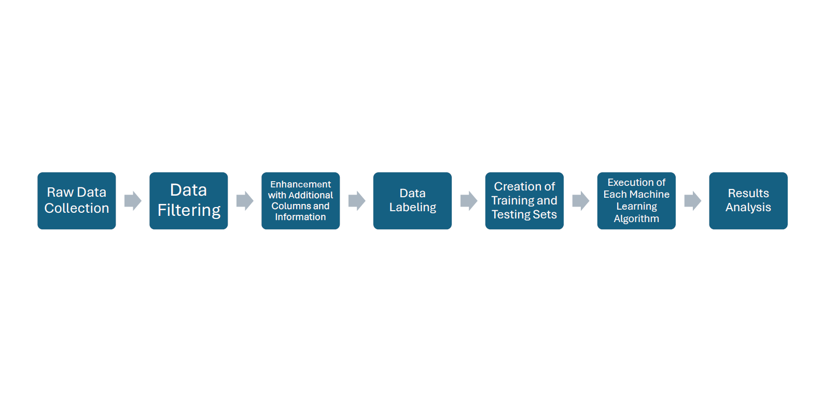
Workflow of our project

Slide 19
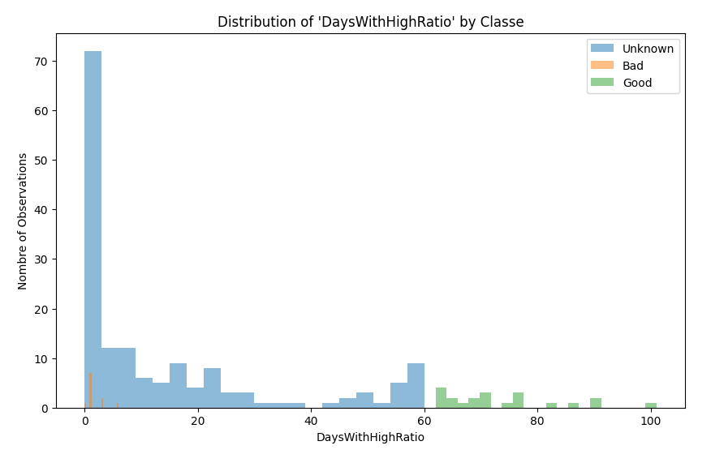

Data Collection and Features
SizeLoansUSD
SizeCollateralUSD
sizeReimbursementsUSD
numLoansUser
maximumDebt
NumReimbursementsUser
RatioCollateralToLoans
AverageOfDailyCollateralToDebt
NumTransactionsUser
TimeStampFirstAnyTransactionAccount

Slide 20
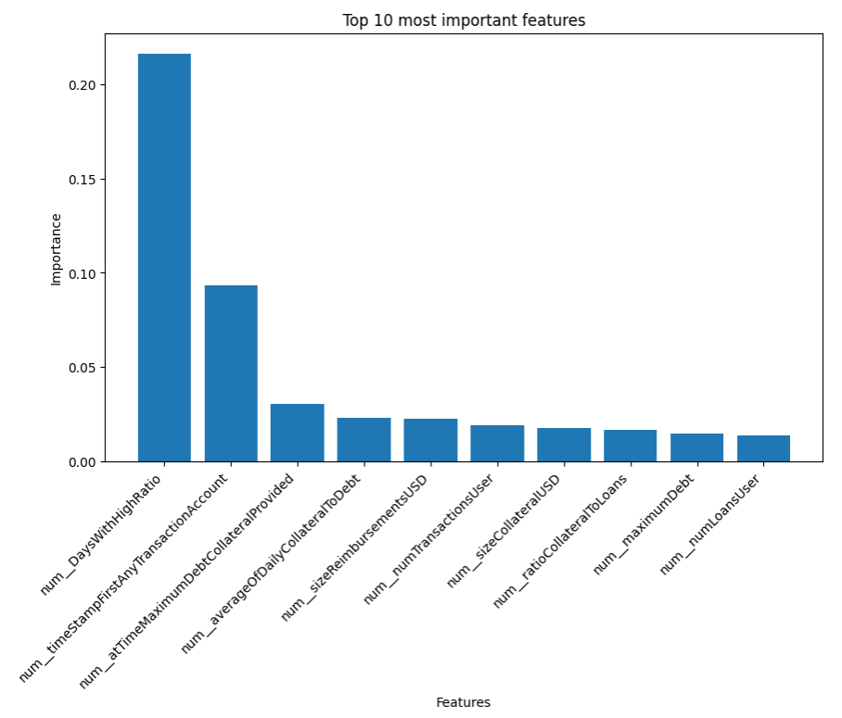
Algorithm Development - Foundation
Foundation: Algorithm based on user behavior and transactional data.
Key Features: Duration of account activity, repayment history, and collateral-to-loan ratio.
Function Design: evaluate_user_behavior to assign credit categories.
Scoring Criteria: Points system based on user's transactional patterns and loan management.
Categories Defined: Users are classified as 'Good', 'Bad', or 'Unknown' based on points accumulated.

Slide 21
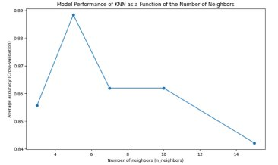
Maximizing Model Accuracy through Iterative Testing
Comprehensive Model Exploration: Our project involved experimenting with a variety of machine learning models to find the most effective approach.
Hyperparameter Tuning: Each model underwent extensive hyperparameter adjustments to enhance performance and achieve optimal accuracy.
KNN Focus: A key part of our analysis included varying the 'k' value in the KNN algorithm, closely examining its impact on accuracy.

Slide 22
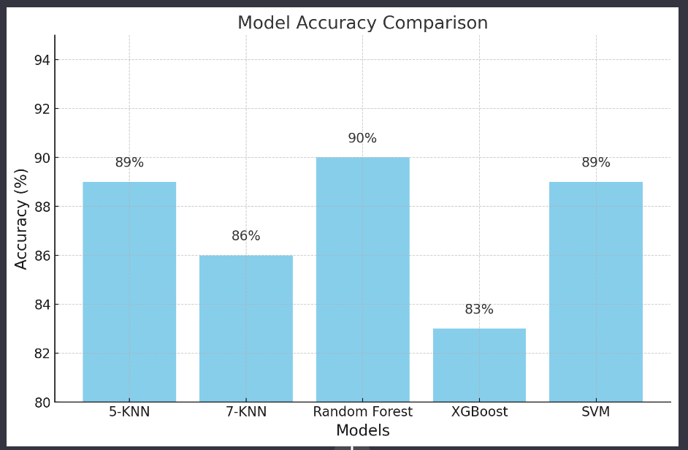
Comparative Analysis of Machine Learning Model Accuracies

Slide 23
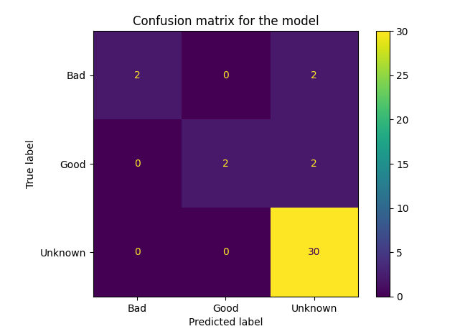
Model Evaluation
Evaluation Metrics: Used confusion matrix to measure the model's precision and recall.
Random Forest Results: High accuracy in classifying 'Unknown' users, moderate for 'Good' and 'Bad'.
Optimal Configuration: Random Forest with fine-tuned hyperparameters outperformed other models.

Slide 24
Comparative Analysis of Loan Classification Examples
Good Classification
Bad Classification
Real and Predicted Class: Unknown
Key Features:
Loan Size: 200.0 USD
Collateral Size: 951.86 USD
Repayments: 200.00 USD
Number of Loans: 1
Collateral/Loans Ratio: 4.76
Transactions: 7
Collateral Withdrawal: Yes
UserMoreThanOneYear: No
Real Class: Good, Predicted Class: Unknown
Key Features:
Loan Size: 400.00 USD
Collateral Size: 2060.49 USD
Repayments: 400.13 USD
Number of Loans: 3
Collateral/Loans Ratio: 5.15
Transactions: 18
Collateral Withdrawal: Yes
UserMoreThanOneYear: Yes

Slide 25
Limitation and future work
Defining 'Good' Users: Criteria for 'Good' require further refinement to capture reliable borrowers accurately.
Expansion of Data Sources: To enrich the dataset, considering integration of additional DeFi platforms such as Aave and Compound v2
Algorithm Evolution: Exploration of advanced machine learning techniques, such as neural networks, for improved predictive power.
Regulatory Compliance: Continuous alignment with evolving DeFi regulations and privacy standards.
Time-windowing solution
Notes:
Our proposed alternative to enhance the credit scoring model involves the implementation of a 'time-windowing' approach, where new user registrations are structured at consistent intervals, such as monthly. This strategy not only facilitates a continual influx of fresh users but also plays a crucial role in reducing the proportion of low-quality users, a phenomenon observed in similar dynamic environments like streaming platforms. This method ensures a regular 'regeneration of the user base', maintaining the robustness and relevance of our scoring system.

Slide 26
Conclusion
Pioneering Approach: Developed a ML algorithm to reduce collateral requirements in DeFi.
Significant Impact: Potential to democratize access to finance by lowering entry barriers.
Proven Methodology: Validated the model with Compound V3 data, with promising initial results.
Commitment to Excellence: Ongoing efforts to refine the model and expand its capabilities.
Our project has successfully tackled the problem of anonymity, which was a key factor in driving up collateral requirements.
However, it's important to acknowledge that the issue of volatility remains unresolved within the scope of our current solution.

Slide 27
References
Compound :https://learn.bybit.com/defi/what-is-compound-crypto/
Compound : https://www.kraken.com/learn/what-is-compound-comp
Aave : https://www.investopedia.com/what-is-aave-6823617
Credit Score Model for Loans: https://www.mdpi.com/1911-8074/13/8/180

